Slide 1
Practice Lab:
This Practice Lab is dependent on Discussion Unit 6260, where most of the objects we create in this lab were introduced.
The goal of this practice lab is to download and use EBDSE.
Use EBDSE
Notes:
The goal of this Practice Lab is to download and use EBDSE.

Slide 2
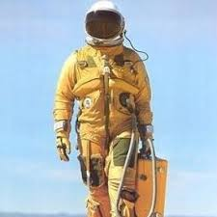
Challenge 1: Download and Use EBDSE
Download EBDSE
Following the documentation run a few tests
Telemetry
Telemetryops
View the keyspaces and tables created
If you have time try to customize a yaml to build something you are interested (think project)

Slide 3
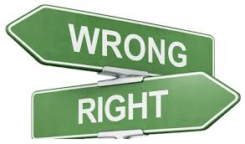
Practice Lab:
Lessons Learned
Notes:
Discuss what worked well, poorly, from the Practice Lab.

Slide 4
Notes:
End of Practice Lab-

